Slide 2
Q&A session will immediately follow the presentation
Type your questions in the side panel at any time. We’ll aim to cover as many as possible.
This webinar is being recorded, and will be freely available to attendees in the days following the presentation

Slide 3
Helps manage all aspects of a home health agency
Cloud-based solution, mobile ready, with built-in EVV
All-payer billing solution
Ideal for skilled & non-skilled health, all disciplines, multiple business lines
Everything you need is in one place
Simplifies all the tasks associated with running your agency
www.AloraHealth.com 1-800-954-8250

Slide 4
Specializes in home health & hospice billing
Dedicated to getting you paid up to 3x faster
Billed over 800 million dollars in claims
Simplified billing for peace of mind
www.imarkbilling.com 1-888-370-3339

Slide 5
ALORA & Imark are prepared to help you through these important billing changes. If you’d like more information or a demo of our solutions…
www.AloraHealth.com/demo
1-800-954-8250
www.imarkbilling.com/contact-us
1-888-370-3339

Slide 6
Our featured speaker
Lynn Labarta, BS
Home Health & Hospice Billing & Coding Specialist
CEO & Founder of Imark Billing

Slide 7
Objectives
Learning Objectives:
Requirements on filing an NOA
What is the difference between an NOA & NO PAY RAP
Penalties for late filling NOA
Key considerations for the implementation of NOA
HHA actions steps

Slide 8
NO PAY RAPS vs NOA
Current 2021 No PAY RAP:
Currently agencies are billing RAPs - Type of Bill (TOB) 322
for each 30-day payment period
Effective Jan 1, 2022 NOA (Notice of Admission):
NOA – TOB (32A) will be required for periods of care beginning on and after January 1, 2022.
Similar to the No Pay RAP Process
5 calendar day submission of NOA is still required
Penalties applied for late submission of NOA
Exception it’s a one-time NOA submission @ admission

Slide 9
NOA (Notice of Admission)
Establishes Home Health “Admission Period”
From date through the D/C date
Only one NOA is required for any series of HH periods of care beginning with admission to home care and ending with discharge.
If a patient is D/C and then readmitted to the agency a new NOA is required within 5 calendar days of the new SOC
Final Claims for every 30 day period are still required for payment

Slide 10
NOA Requirements
One-time submission upon SOC
Can be keyed directly into DDE or Billed through your software
Must be submitted timely
A timely-filed NOA must be accepted by the MAC (HHH) within five calendar days after admission date.

Slide 11
NOA & Claim Submission
Admission Period
SOC
D/C
NOA
Submission with 5 calendar days
1st 30 day period
2nd 30 day period
Bill 2nd FINAL Claim
Bill 1st FINAL Claim

Slide 12
NOA Requirements
The HHA can submit an NOA to Medicare when:
The HHA has obtained a verbal or written order from the physician that contains the services required for the initial visit, and
The HHA has conducted an initial visit at the start of care.

Slide 13
NOA Non-Timely filing Penalties
In instances where an NOA is not timely-filed, Medicare shall reduce the payment for a period of care, including outlier payment, by the number of days from the home health admission date to the date the NOA is submitted to, and accepted by, the A/B MAC (HHH), divided by 30.
This reduction shall be a provider liability, and the provider shall not bill the beneficiary for it.
Reduction amount will be displayed with value code “QF” on claim

Slide 14
NOA Penalty Exceptions
CMS exceptions policy for failure to meet timely filing of the NOA;
an HH may be eligible for an exception to the consequences of late filing of the NOA if it documents and requests an exception based on 4 circumstances listed below and the MAC grants the exception:
Fires, floods, earthquakes, or other unusual events that inflict extensive damage to the HHA’s ability to operate;
An event that produces a data filing problem due to a CMS or MAC systems issue beyond the control of the HHA;
A newly Medicare-certified HHA that is notified of that certification after the Medicare certification date, or which is awaiting its user ID from its MAC; or
Other circumstances determined by CMS to be beyond the control of the HHA

Slide 15
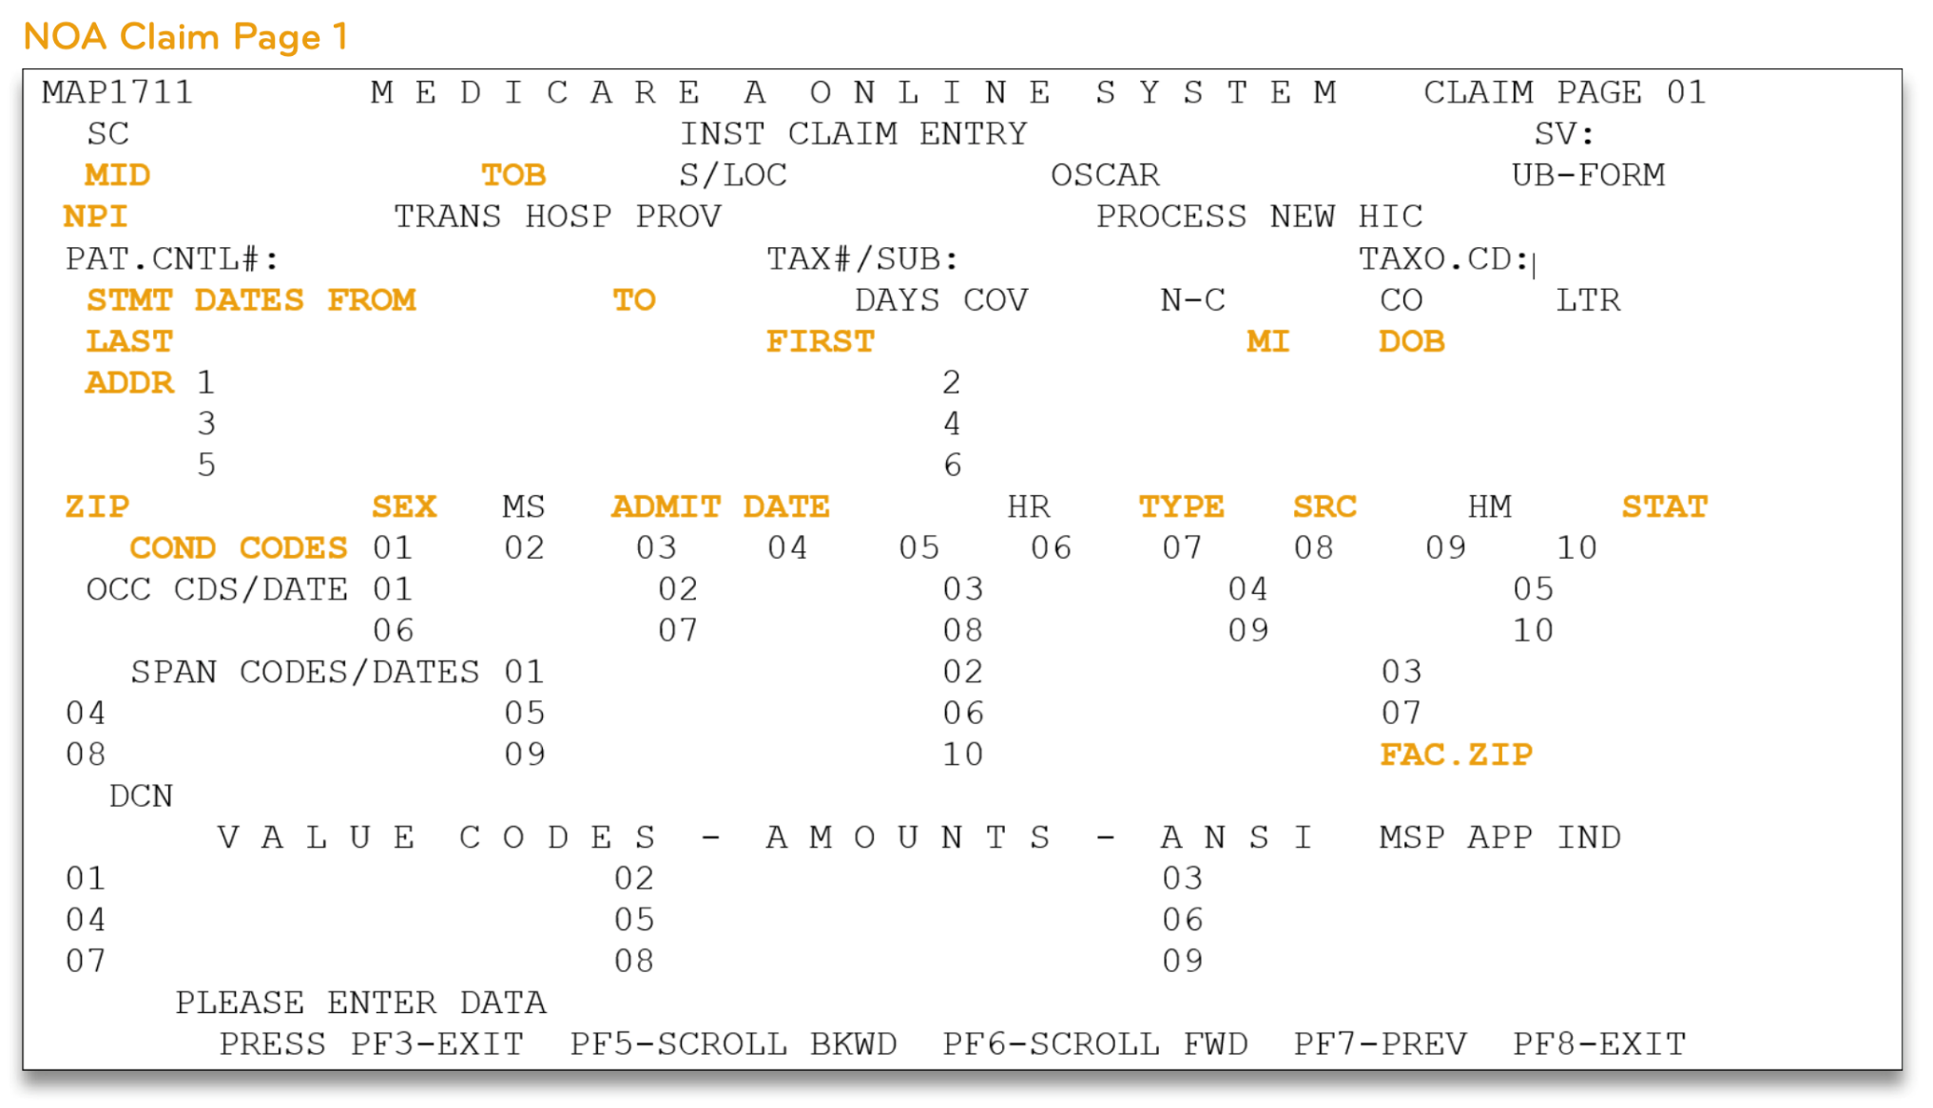
Billing of the NOA

Slide 16
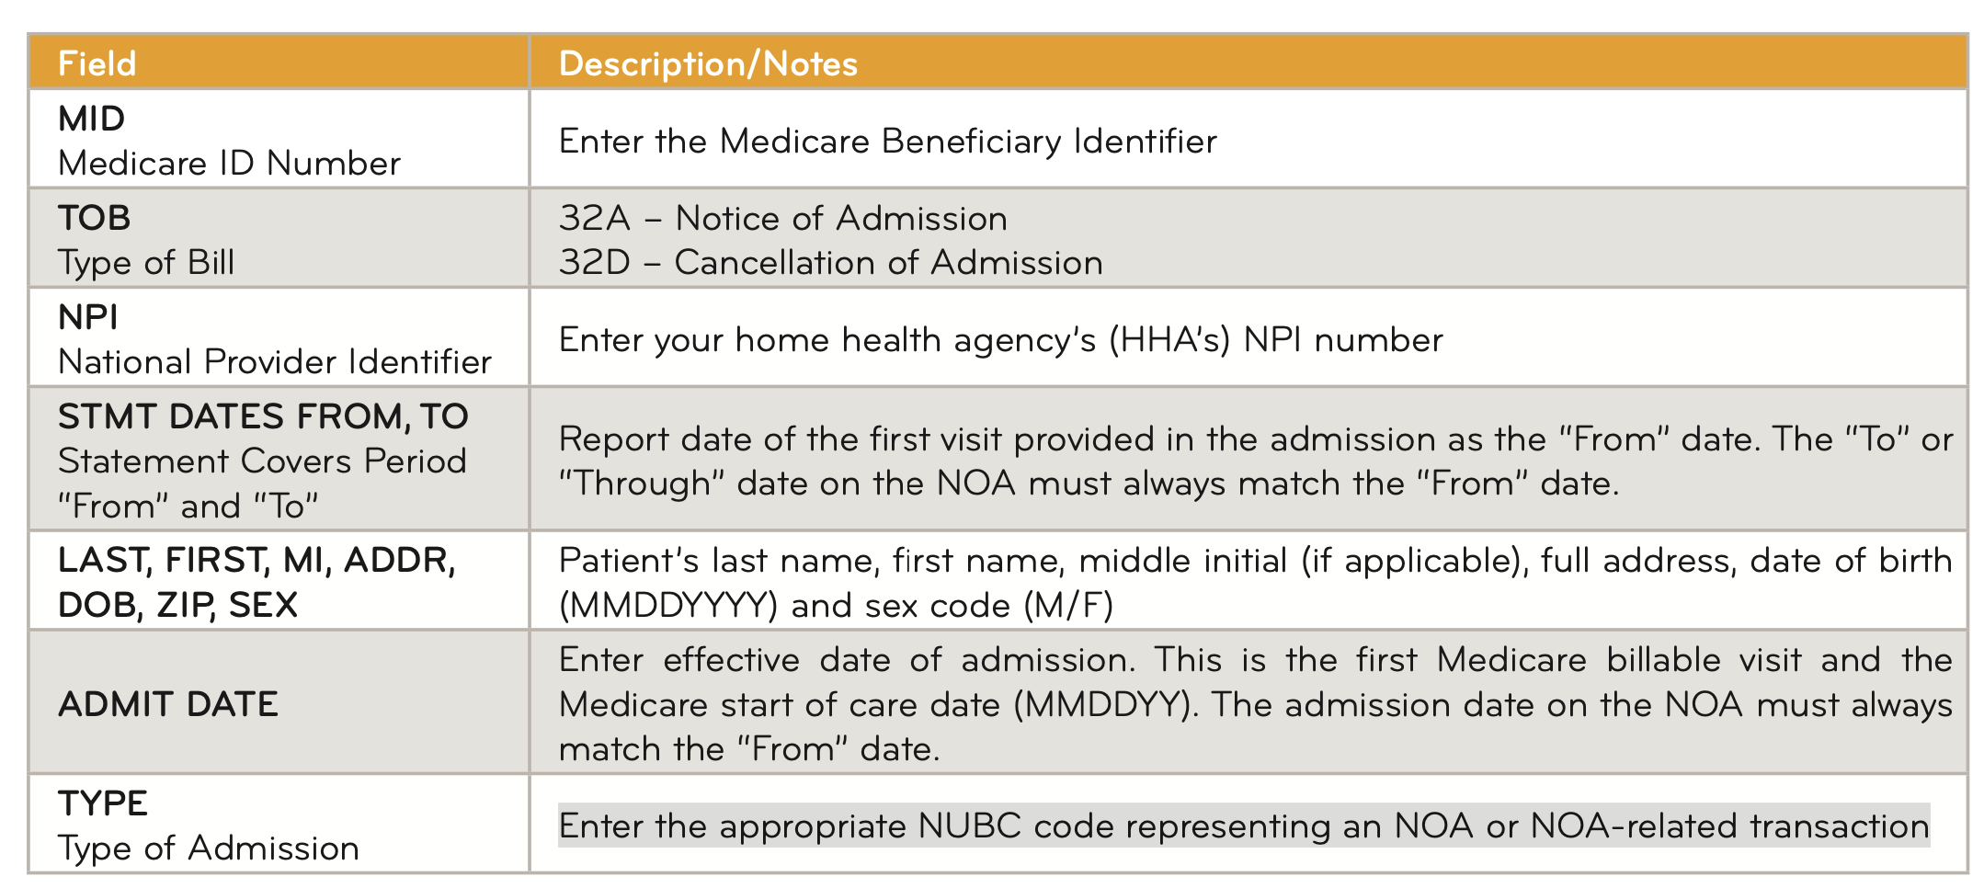
Billing of the NOA

Slide 17
Billing of the NOA

Slide 18
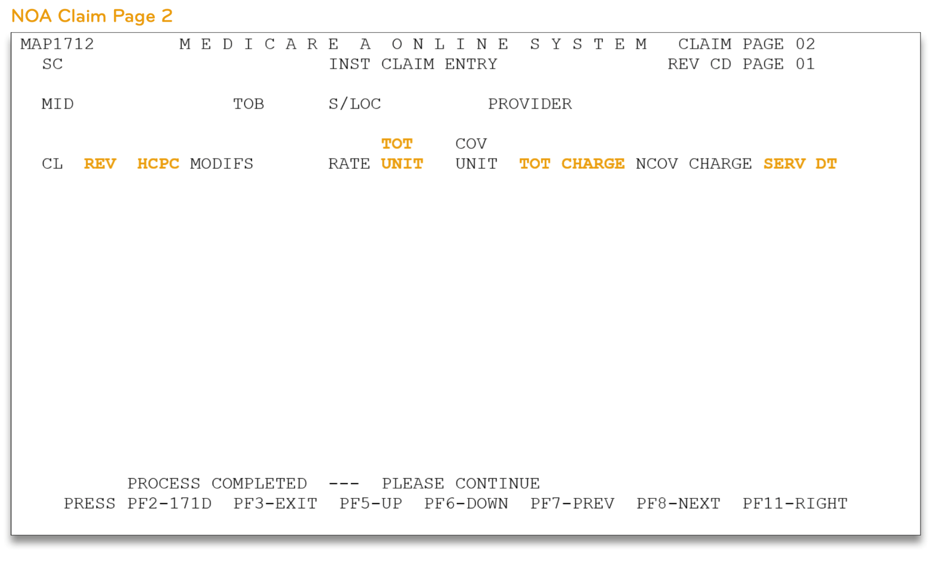
Billing of the NOA

Slide 19
Billing of the NOA

Slide 20
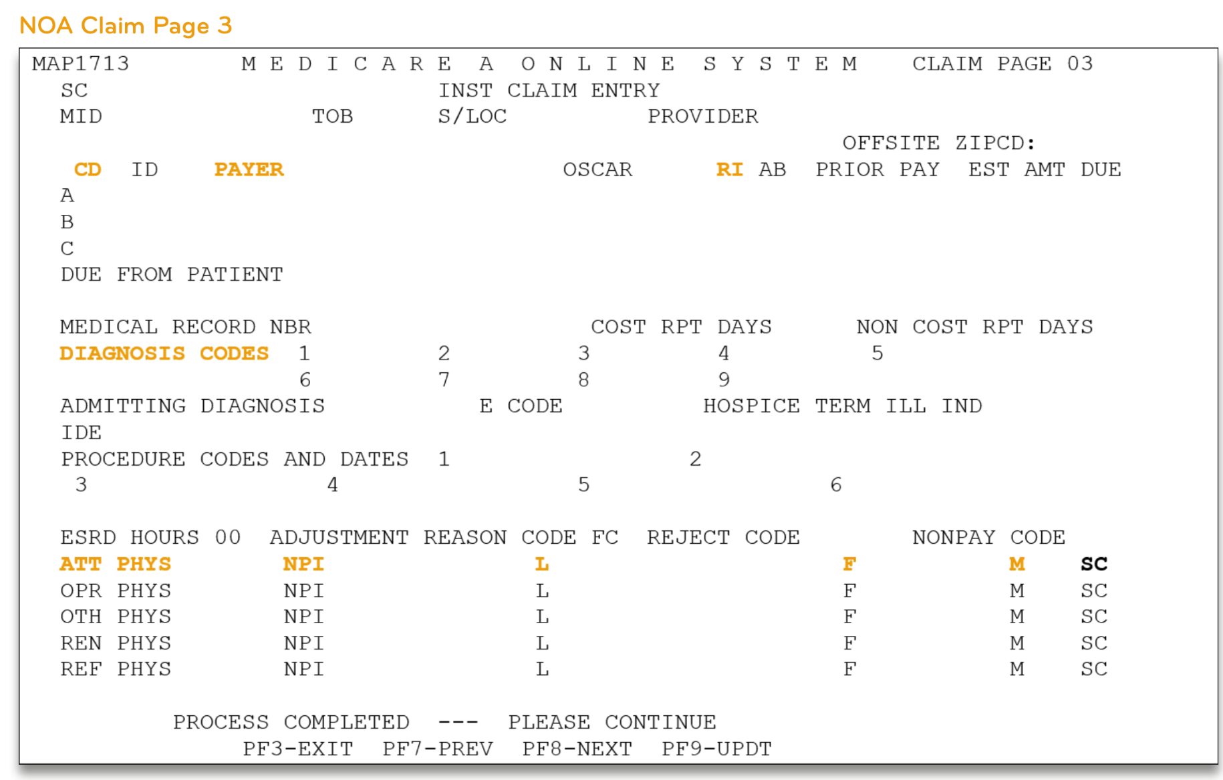
Billing of the NOA

Slide 21
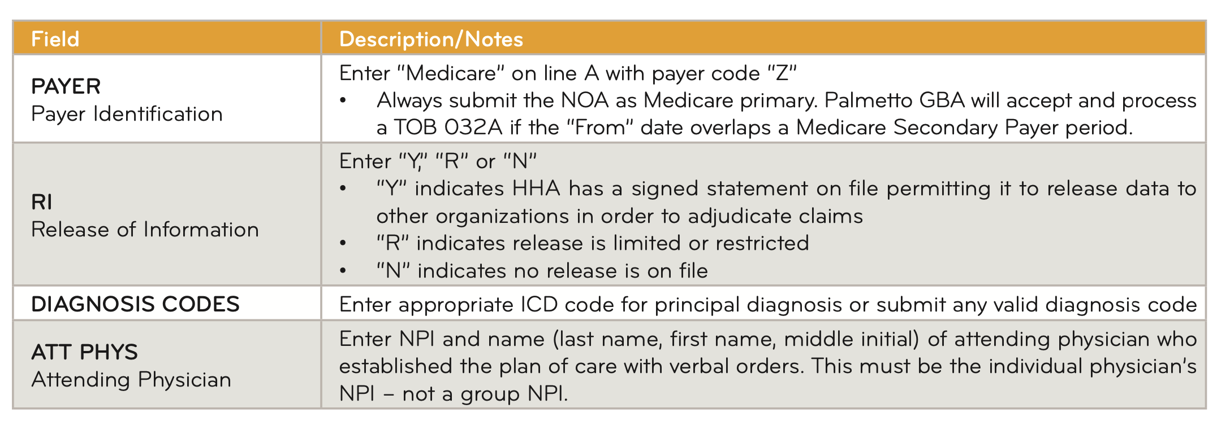
Billing of the NOA
www.imarkbilling.com

Slide 22
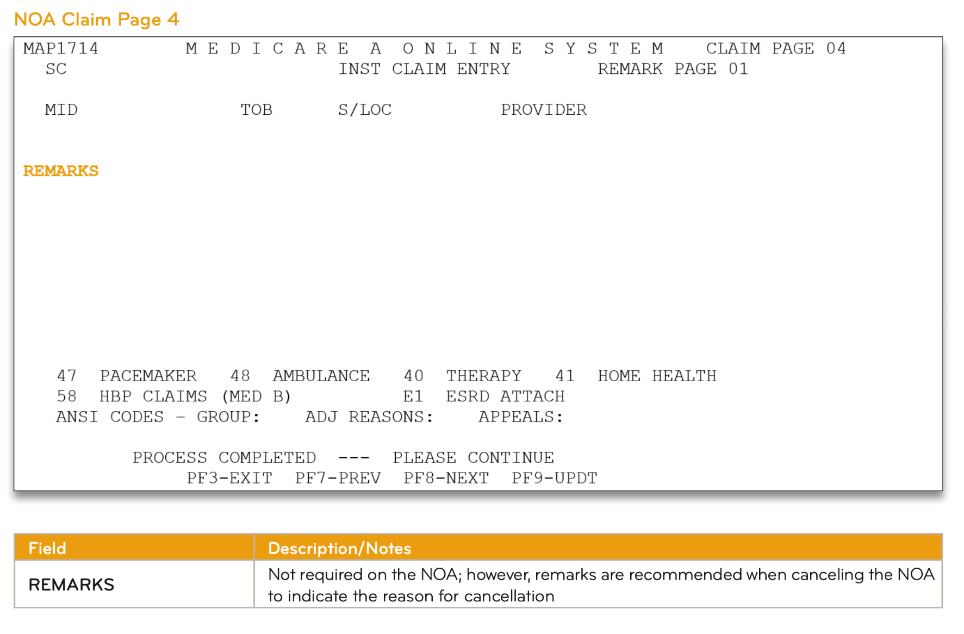
Billing of the NOA

Slide 23
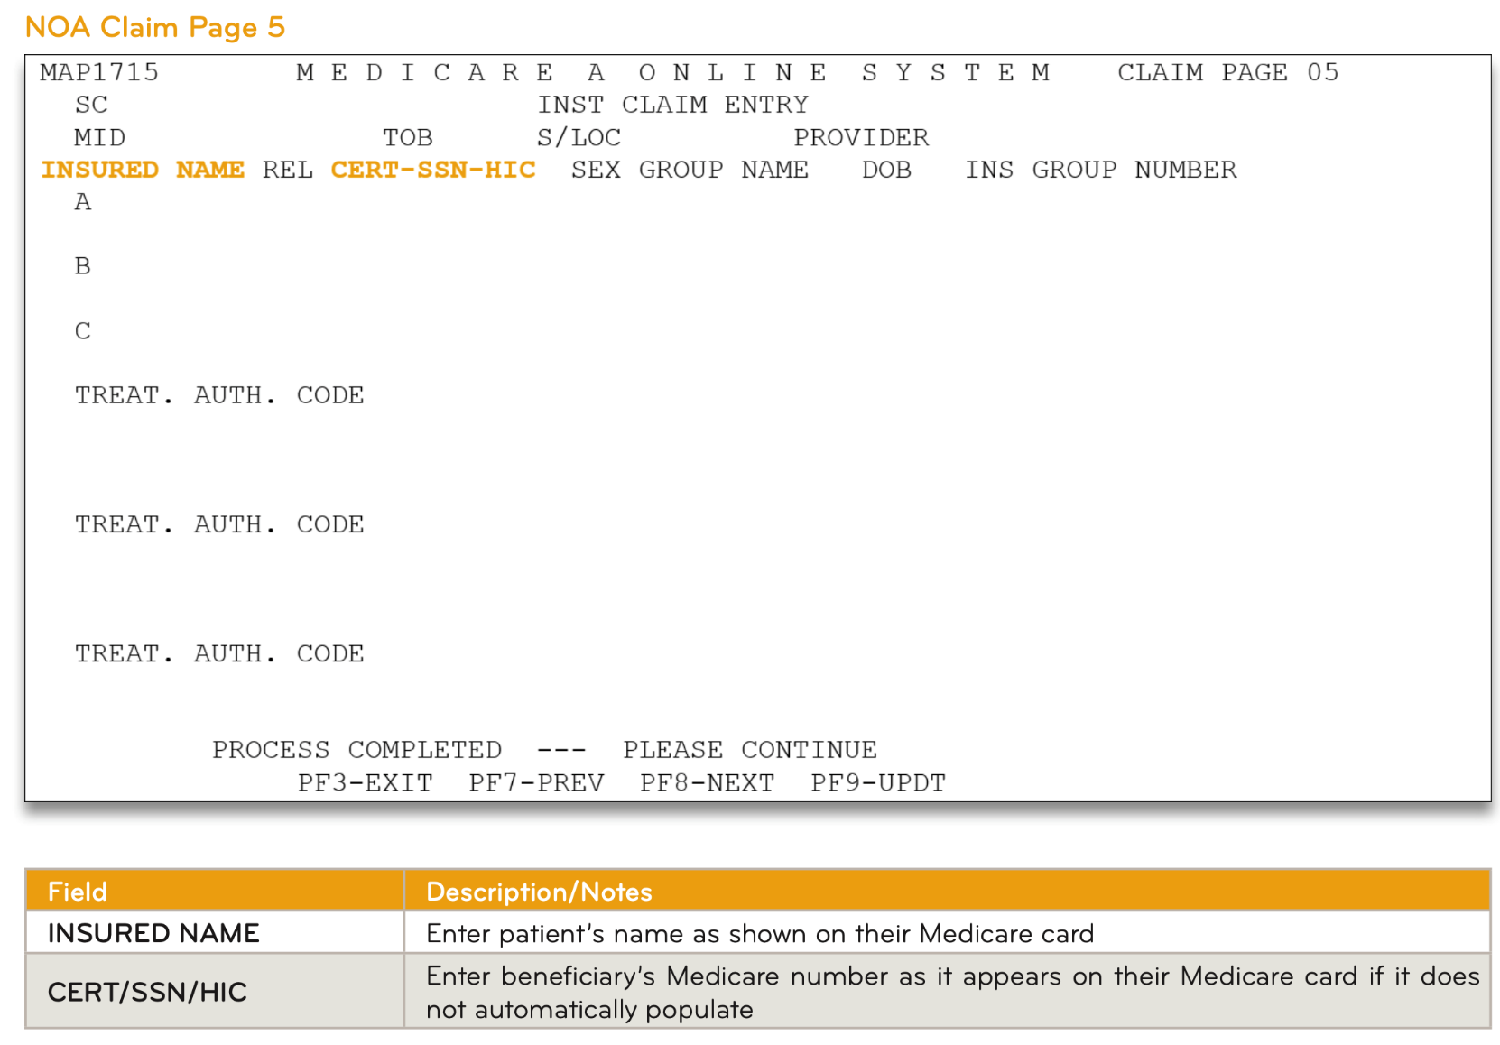
Billing of the NOA

Slide 24
Implementation of NOA
Patients Continuing Care in 2022
the HHA shall submit an NOA with a one-time, artificial ‘admission date’ corresponding to the "From" date of the first period in 2022.
For example, if the start of care is 12.13.21, the first 30-day period of care runs from 12.13.21 – 01.11.22.
You would need an NOA on 01.12.22 for a new period in CY2022.

Slide 25
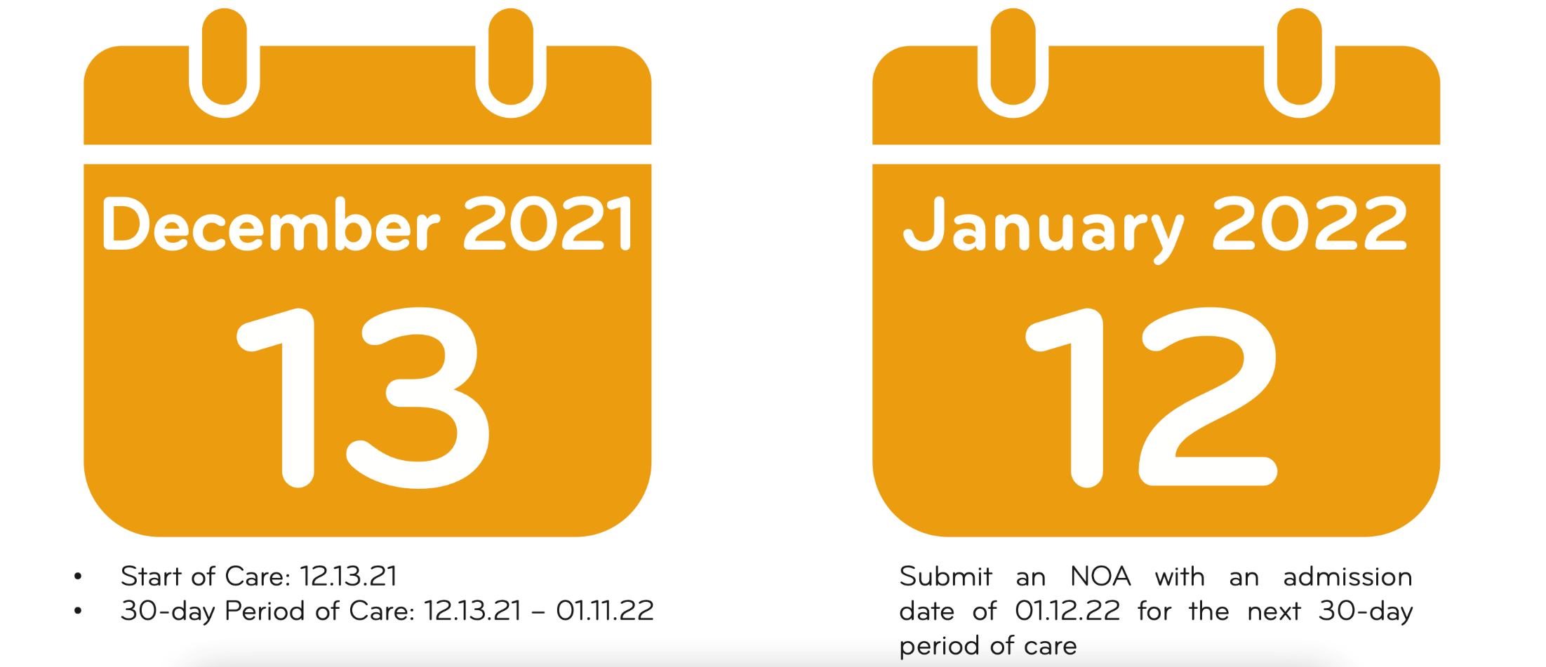
Implementation of NOA

Slide 26
Action Steps
Transition of NOA in January 2022
Educate your billing team on NOA and specifically on the transition guidance
Prepared for increased work in January
Be prepared for errors by the MAC during the implementation period for NOA
Be mindful of the 5 calendar day submission requirements to avoid penalties

Slide 28
ALORA & Imark are prepared to help you through these important billing changes. If you’d like more information or a demo of our solutions…
www.AloraHealth.com/demo
1-800-954-8250
www.imarkbilling.com/contact-us
1-888-370-3339

Slide 29
SPECIAL OFFER
VISIT www.AloraHealth.com/demo
PROMO CODE: NOA22
Implementation Fee Waived

