Slide 2
WELCOME
BUILDING SPECIALTY DISEASE PROGRAMS
Overview Benefits Details
www.chapinc.org
202-862-3413
www.AloraHealth.com
1-800-954-8250

Slide 3
Q&A session will immediately follow the presentation.
Type your questions in the side panel at any time. We’ll aim to cover as many as possible.
This webinar is being recorded and will be freely available to attendees in the days following the presentation.
Today’s webinar will follow a roundtable format, as CHAP experts discuss specialty disease programs
Hosted by:
Imari Adams, BS
Alora Home Health Software, Marketing & Event Manager

Slide 4
Helps manage all aspects of a home health agency
Cloud-based solution, mobile ready, with built-in EVV
All-payer billing solution
Ideal for skilled & non-skilled health, all disciplines, multiple business lines
Everything you need is in one place
Simplifies all the tasks associated with running your agency
www.alorahealth.com 800-954-8250

Slide 5
The first accrediting body for community-based health care organizations
Founded in 1965
Nationally-approved CMS deeming authority
Provides accreditation for a variety of home and community-based healthcare organizations
www.chapinc.org 202-862-3413

Slide 6
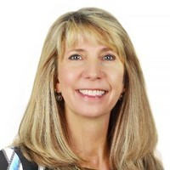
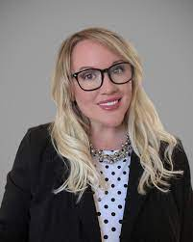
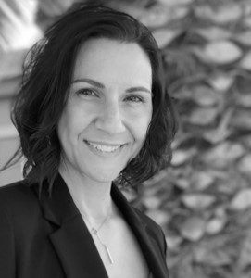
Our featured panelists:
Teresa Harbour, RN, MBA, MHA
CHAP Senior Vice President of Accreditation
Meredith Darabasz, MSN, RN
CHAP Director of Growth Strategy
Denise Stanford, MS, SHRM-CP
CHAP Executive Director, Center for Excellence

Slide 7
Let’s get started!
www.chapinc.org
202-862-3413
www.AloraHealth.com
1-800-954-8250

Slide 8
What is a Specialty Disease Program?

Slide 9
Why do you think Specialty Disease Programs have become more popular in the last 5 years?

Slide 10
Why is it important to have certified disease-specific training for both patients and staff?

Slide 11
What are the 3 most common diseases we’re seeing and caring for in the home?

Slide 12
SIX DISEASE PROGRAMS
Wound care
Diabetes
Stroke Recovery
Heart Failure
Dementia
COPD

Slide 13
What are the fundamentals of building a disease program for community-based healthcare, and what is CHAP looking for when certifying one?

Slide 14
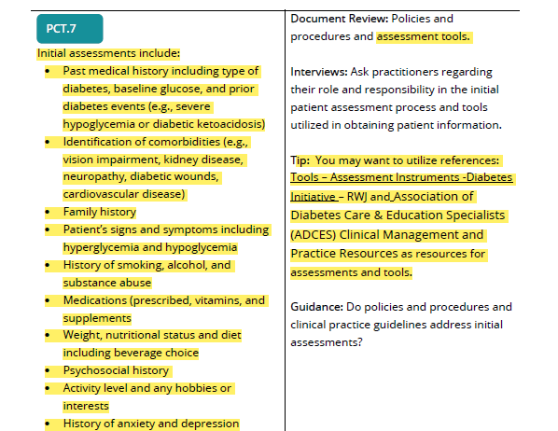
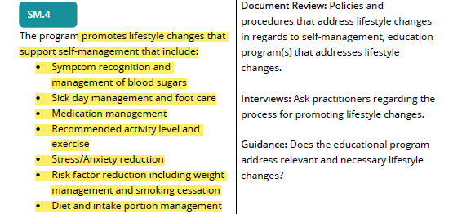

Slide 15
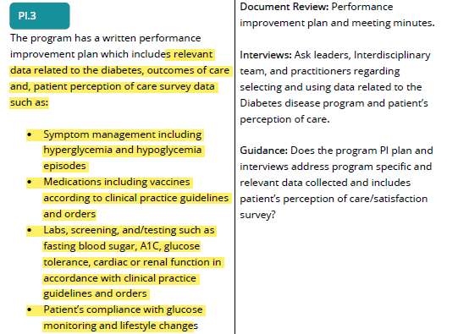
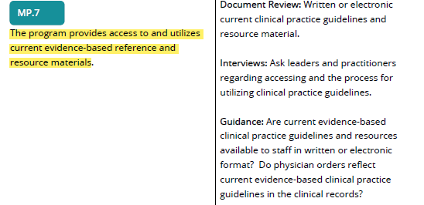

Slide 16
How can you leverage specialty training to demonstrate its value to prospects?

Slide 17
How can specialty training lead to increased employee and patient retention?

Slide 18
What’s the process for becoming certified?

Slide 19
What other programs does the CHAP Center for Excellence offer?
Hospice Operations Certification
Home Health Operations Certification
Healthcare Sales Certification
Accreditation Intensives

Slide 20
Next steps
Call Gaby Flores – Customer Advisor at 202-467-1718
VISIT: education.chaplinq.org
Use discount code ALORA for $100 off
www.chapinc.org
202-862-3413

Slide 21
How does Alora help?
www.AloraHealth.com
1-800-954-8250

Slide 22
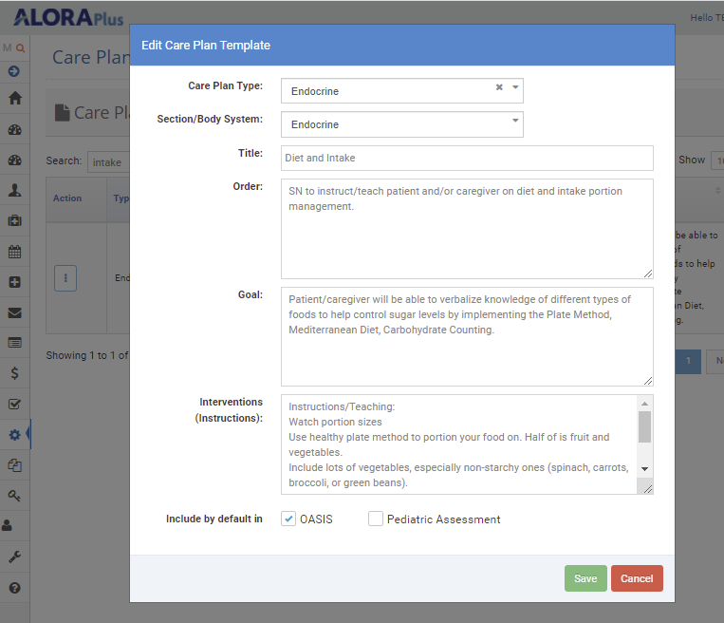

Slide 23
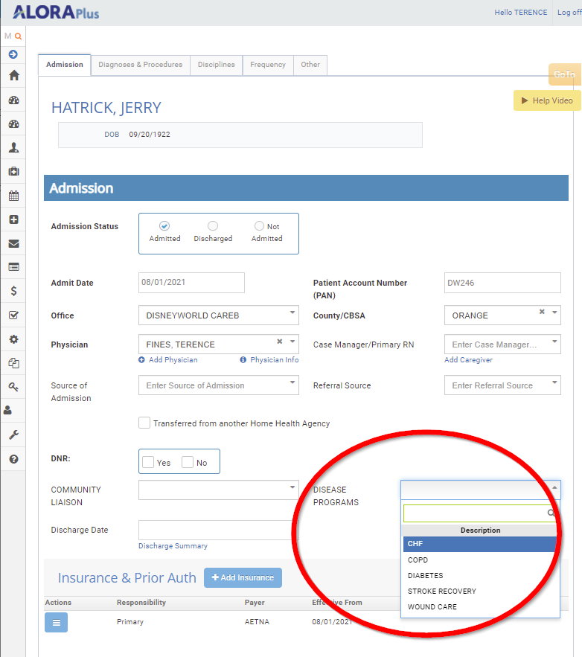

Slide 24
Simplified Agency Workflow
Custom documents
Comprehensive assessments/POC/Notes
www.AloraHealth.com
1-800-954-8250

Slide 25
Q&A
www.chapinc.org
202-862-3413
www.AloraHealth.com/demo
1-800-954-8250

Slide 26
Have additional questions for our expert CHAP panelists?
Denise Stanford: denise.stanford@chapinc.org
Meredith Darabasz: meredith.darabasz@chapinc.org
Teresa Harbour: Teresa.harbour@chapinc.org
www.chapinc.org
202-862-3413
www.AloraHealth.com/demo
1-800-954-8250

Slide 27
Thanks for attending!
SPECIAL OFFER:
VISIT www.AloraHealth.com/demo
PROMO CODE: SPECIALTY22
***Implementation Fee Waived***

